Slide 1
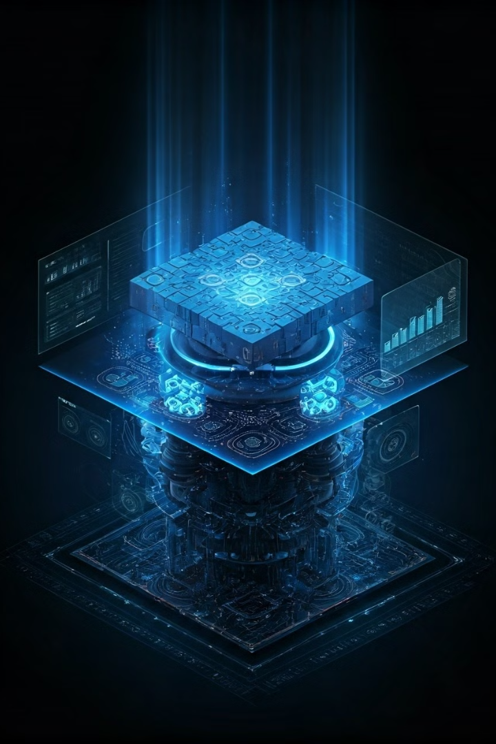

Quantum Game Solver
Harnessing quantum computing for puzzle solving.
by Rachana Pusuluri

Slide 2
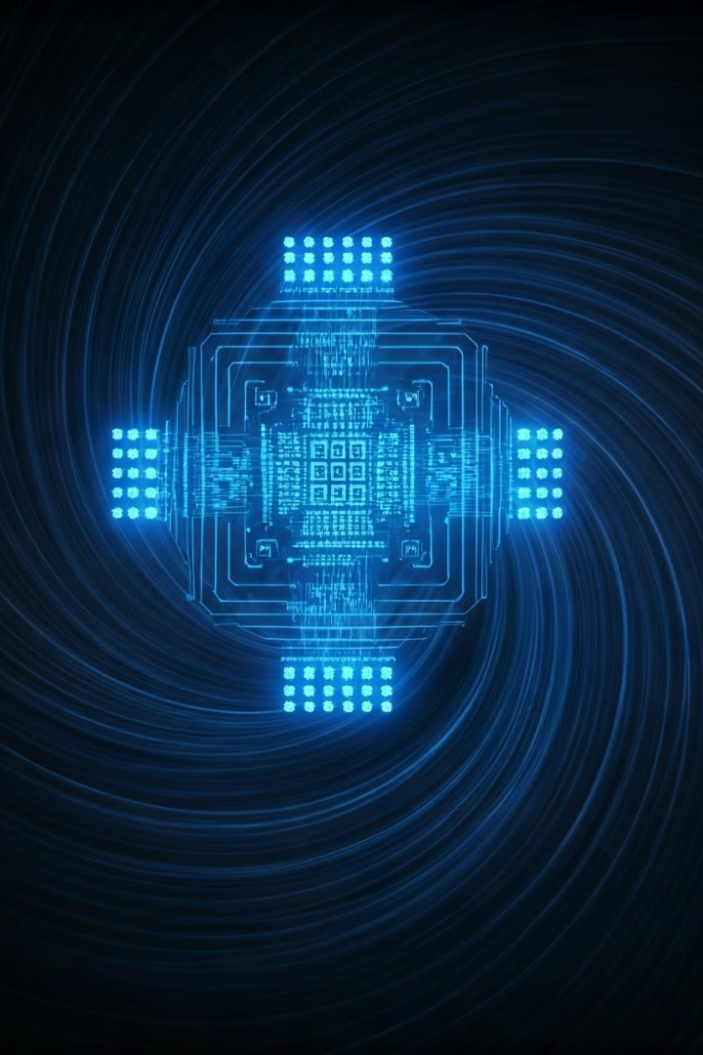
Introduction to Quantum Computing
1
Quantum Principles
Leverages quantum mechanics for faster calculations.
2
Qubits
Exist in multiple states, unlike classical bits.
3
Computational Power
Handles vast possibilities simultaneously for complex problem-solving.

Slide 3

Quantum Computing in Games
1
Simultaneous Exploration
Explores all possible solutions at once.
2
Grover's Algorithm
Offers quadratic speedup in search problems.
3
Efficient Solving
Reduces computation time for complex game tasks.

Slide 4

Project Overview: Quantum Game Solver
Focus
Goal
Integration
Demonstrate quantum computing for solving puzzles efficiently.
Create simulator with real-time quantum-enhanced algorithms.
Combines quantum algorithms, game logic, and user interface.

Slide 5




Technologies Used
Python
Develops game logic and integrates computing elements.
Qiskit/Cirq
Provides quantum algorithms for computing solutions.
Flask/Django
Builds interactive web interface for user interaction.

Slide 6
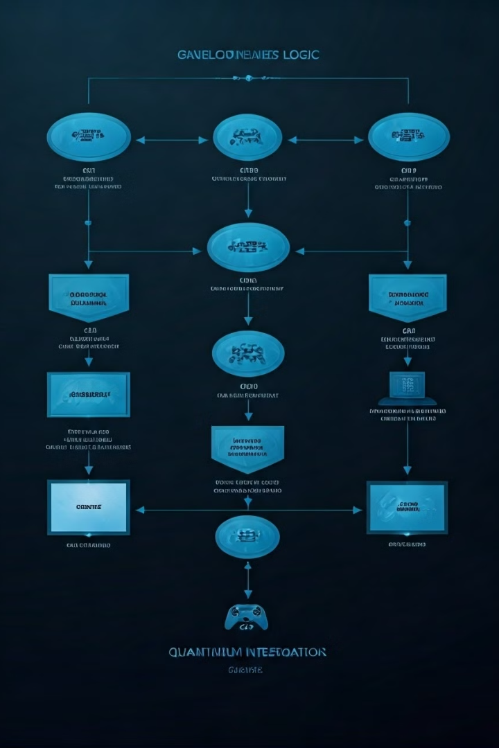



Game Logic Development
Classical Logic
Developed in Python for puzzles and games.
User Interaction
Handles moves, board updates, and game states.
Quantum Integration
Feeds game states into quantum algorithms.

Slide 7
Quantum Algorithms for Puzzle Solving
Grover's Algorithm
Quantum Search
Computation Time
Quadratic speedup for unstructured search problems.
Evaluates larger number of moves efficiently.
Significantly reduces time to find game solutions.

Slide 8

Quantum Game Solver Workflow
Quantum Computing
Input
Quantum algorithms applied for solutions/moves.
User provides game/puzzle input.
1
2
3
4
Game Logic
Output
Classical Python processes input and rules.
Solver provides real-time solution.

Slide 9

Interactive Gameplay
Web Interface
Players interact through Flask/Django interface.
Quantum Assistance
Algorithms show optimal moves in real-time.
Unique Experience
Demonstrates practical application of quantum computing.

Slide 10
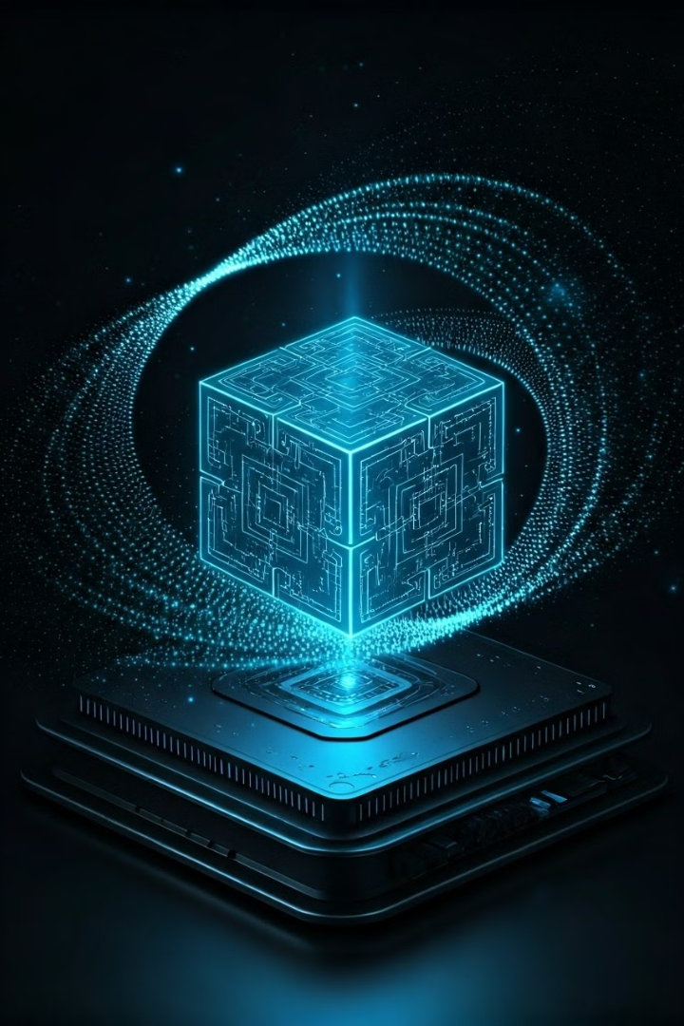
Conclusion
1
Innovation
Quantum Game Solver revolutionizes puzzle-solving.
2
Efficiency
Demonstrates quantum computing's power in game solutions.
3
Future Potential
Opens new possibilities in gaming and problem-solving.

